Slide 1
AIR QUALITY PREDICTION USING DEEP LEARNING ARTIFICAL NEURAL NETWORK(ANN)
BY : LIZARE SHERINE M

Slide 2
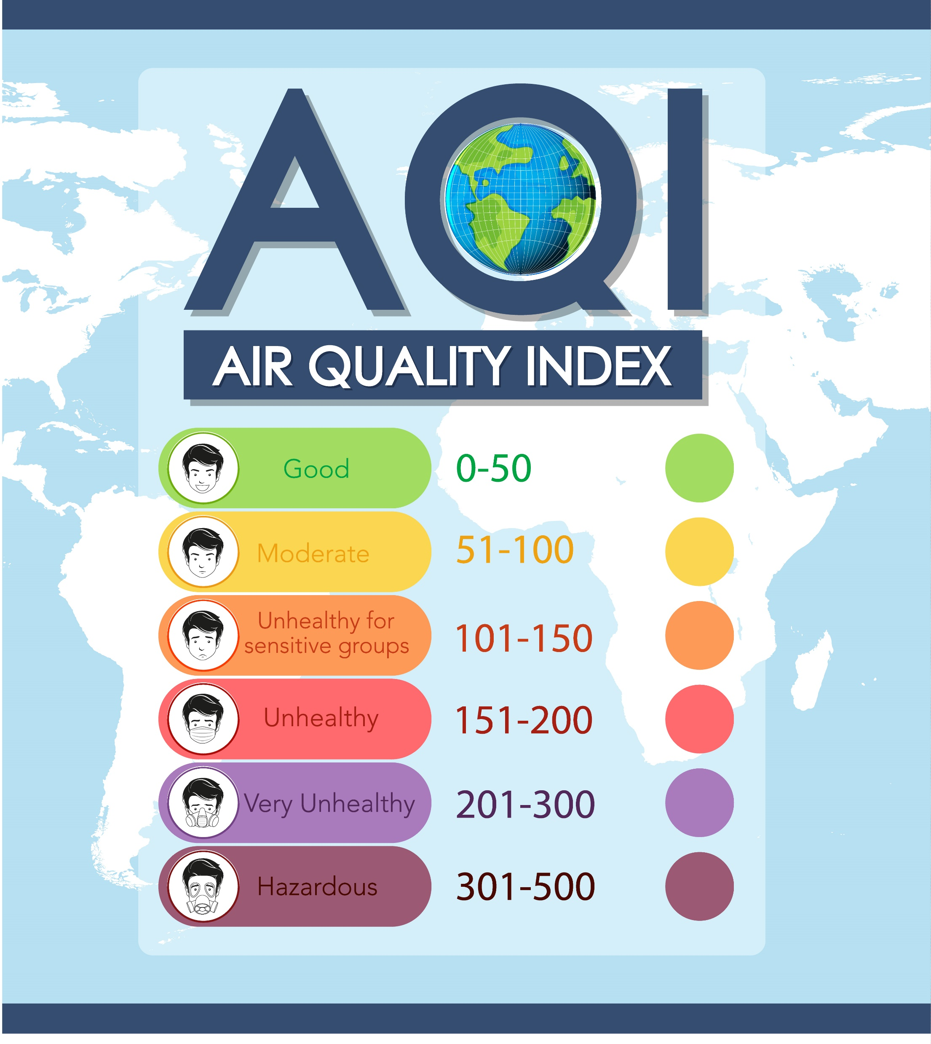
INTRODUCTION
Air pollution is a major environmental and health concern
Pollutants like PM2.5 and PM10 severely affect human health
Predicting air quality in advance helps in early warnings and planning
Deep Learning models can capture complex pollution patterns
Figure 1 : This image shows the Air Quality Index scale, which categorizes air pollution levels from good to hazardous.
FIGURE 1 : AQI SCALE

Slide 3
PROBLEM STATEMENT AND OBJECTIVES
Problem Statement
Traditional air quality monitoring provides only current readings
There is a need to predict pollution levels in advance
The challenge is to handle complex, non-linear relationships between features
This project aims to predict PM2.5 levels using Deep Learning
Objectives
To build a Deep Learning model for air quality prediction
To predict PM2.5 concentration using environmental data

Slide 4
DATASET OVERVIEW
Air quality dataset containing:
PM2.5, PM10 and other pollutant values
Environmental and location-based features
Dataset includes:
Numerical features
Categorical features
Columns in the dataset
Pollutant Features: PM2.5, PM10, NOx, NO2, SO2, VOCs, CO, CO2, CH4
Environmental Features: Temperature, Humidity, Wind_Direction
Categorical Features: Location_Type, Source_Label
Target Variable: PM2.5

Slide 5
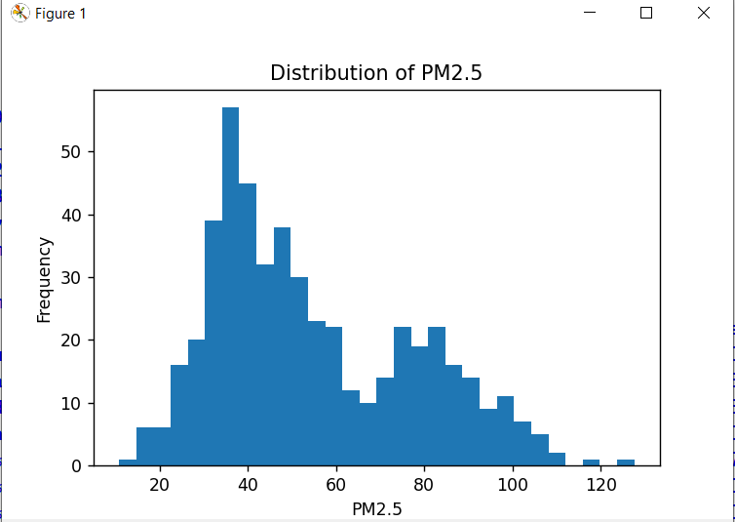
EXPLORATORY DATA ANALYSIS(EDA)
Exploratory Data Analysis was performed to understand the distribution of air pollutants and identify important patterns in the data
Relationships between PM2.5, other pollutants, and location type were analyzed to select meaningful features for prediction.
PLOT 1 : This histogram shows the distribution of PM2.5 concentrations across different locations, helping to understand pollution intensity and data spread.
PLOT 1 : DISTRIBUTION OF PM2.5 LEVELS

Slide 6
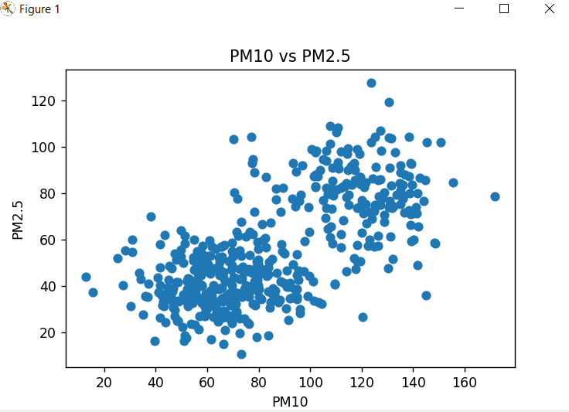
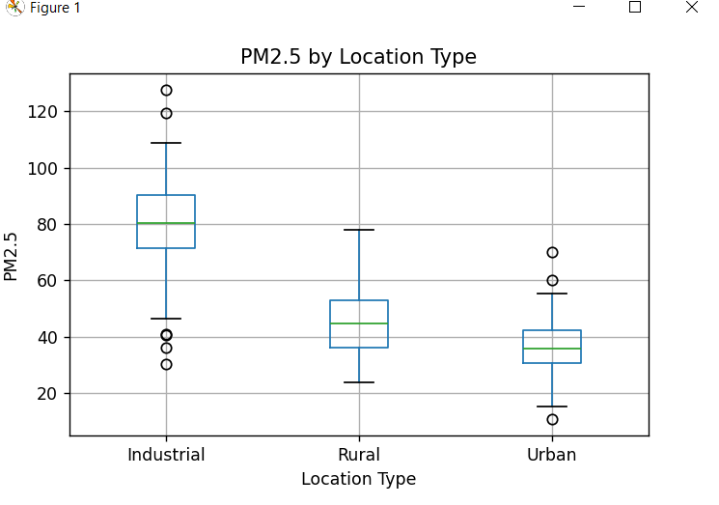
PLOT 2 : This scatter plot illustrates the positive correlation between PM10 and PM2.5, indicating that higher PM10 levels are associated with increased PM2.5 pollution
PLOT 3 : This box plot compares PM2.5 concentrations across Industrial, Urban, and Rural areas, showing higher pollution levels in industrial regions
PLOT 3 : PM2.5 Levels by Location Type
PLOT 2 : Relationship between PM10 and PM2.5

Slide 7
DATA PREPARATION
Input features and target variable were separated for model training
Numerical features were scaled using StandardScaler to improve ANN performance
The dataset was split into training and testing sets

Slide 8
ANN MODEL ARCHITECTURE
An Artificial Neural Network (ANN) was designed for air quality prediction
The model consists of two hidden layers with ReLU activation for learning non-linear patterns
A linear output layer was used to predict continuous PM2.5 values

Slide 9
MODEL TRAINING AND MODEL EVALUATION
Model Training
The model was trained using scaled training data
A validation split of 20% was used to monitor performance
Training was performed for 100 epochs with a batch size of 16
Model Evaluation
Model performance was evaluated on unseen test data
Mean Squared Error (MSE) and Mean Absolute Error (MAE) were used as evaluation metrics

Slide 10
RESULTS AND CONCLUSION
Result
Predicted PM2.5 values close to actual measurements
Model learned trend from data and converged well
Conclusion
Deep Learning can forecast air quality
Helps in monitoring and planning for pollution

Slide 11
FUTURE ENHANCEMENTS
Add more features like humidity, wind, temperature
Use LSTM/GRU for better time-series predictions
Deploy for real-time monitoring via dashboard or app

